Slide 1

SEO Project Comprehensive SEO Audit & Optimization for Organic Traffic Growth
Suparna
MB30

Slide 2
Company Selection
I selected the company CrimsonLogic https://www.crimsonlogic.com/
Simpler Trade. Smarter Tech.
About CrimsonLogic:
A global technology company and subsidiary of PSA International, driving digital transformation in global trade.
Specializations:
Trade facilitation & compliance
Port operations
Government services
Logistics optimization
Key Achievements:
Pioneered the world’s first single-window trade facilitation system in Singapore.
Operates in 40+ countries delivering tailored, secure solutions. Over 36 years of innovation with cutting-edge technology.

Slide 3

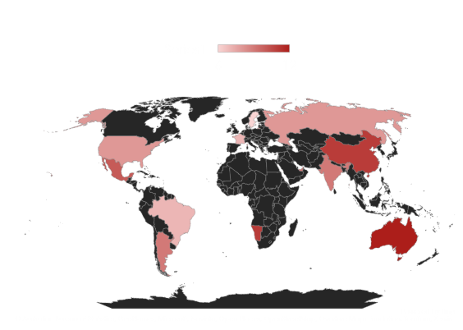
About crimsonlogic company
🔴 Highlighted Areas: Countries where CrimsonLogic operates
⚫ Black Areas: No data available

Slide 4

Task 1 - Initial audit
Current Performance:
Moderate SEO with robots.txt and XML sitemap in place.
Mobile-friendly design but mobile speed is low (44%).
Limited keyword optimization and slow website speed affecting ranking.
Strengths:
36+ years of expertise in trade facilitation and compliance.
Strong global presence in 40+ countries.
Proper technical SEO like crawlability and HTTPS.
User-friendly responsive design for mobile users.
Weaknesses:
Missing structured data for rich snippets.
Low keyword targeting in metadata.
Slow mobile speed impacting engagement.
Limited SEO-optimized content (e.g., blogs, case studies).

Slide 5

Task 2 – keyword research
Targeted Keywords
Digital Trade Solutions:
Trade facilitation software
Global trade compliance
Customs digital systems
Government Technology:
E-government solutions
Digital transformation for governments
Port & Logistics:
Port management systems
Smart logistics solutions
Competitive Analysis
Main Competitors:
Tradelens: Strong in blockchain trade solutions
Wisetech Global: Focuses on freight and logistics software
SAP GTS: Enterprise trade compliance
Opportunities
Use specific keywords like “smart port solutions”
Create content targeting regional markets (e.g., Asia, Africa)

Slide 6
Task 3- On-page seo optimization audit
Selected Pages:
https://www.crimsonlogic.com/crimsonlogic-leadership
Strengths
Canonical Tag Defined: Prevents duplicate content issues.
Language Tag Included: Helps with English-specific search visibility.
Rich Content:
25 images and 149 links provide navigation and information.
Structured Heading (H2): Improves indexing potential.
Weaknesses
Meta Description Missing: Reduces click-through rates.
No Targeted Keywords: Limits page relevance in search results.
Robots Meta Tag Undefined: No clear crawling instructions for search engines.
Missing Author & Publisher Info: Affects credibility.
No H1 Tag: Key heading for SEO is absent.
Image Alt Text Missing: Impacts accessibility and ranking.

Slide 7

Task 4 technical SEO
Technical SEO Issues on CrimsonLogic Homepage
1. Slow Page Load Speed
Solution: Optimize images, minimize JS/CSS, use lazy loading.
2. Missing Meta Description
Solution: Add a concise, keyword-rich meta description.
3. No H1 Tag
Solution: Add an H1 tag to the homepage.
4. Poor Mobile Optimization
Solution: Ensure responsive design for mobile users.
5. Broken Links
Solution: Regularly audit and fix broken links.

Slide 8
Task 5 content strategy
1. Audience-Centric Content
Focus on government agencies, businesses, and logistics providers.
Highlight global trade and logistics solutions.
2. Thought Leadership & Case Studies
Share industry reports and case studies to showcase expertise.
3. SEO-Optimized Web Content
Use targeted keywords to enhance visibility in global trade, port operations, and logistics.
4. Visual Content & Infographics
Use infographics and videos to explain complex systems and innovations.
5. Social Media Engagement
Leverage LinkedIn and Twitter to share webinars and product updates.
6. Content Distribution Strategy
Distribute content through email newsletters, search engine marketing, and partners.

Slide 9

Task 6 off-page seo
Link Building
Focus on obtaining high-quality backlinks from reputable industry websites, logistics blogs, and trade organizations.
2. Social Media Engagement
Share case studies, industry reports, and thought leadership content on LinkedIn and Twitter.
Encourage user-generated content and social shares.
3. Influencer Outreach
Collaborate with industry influencers and thought leaders to create guest posts and feature CrimsonLogic’s solutions.
4. Online Reputation Management
Manage and monitor reviews on platforms like Trustpilot and Google My Business.
Encourage satisfied clients to leave positive feedback.
5. Content Marketing & Guest Blogging
Publish guest posts on reputable trade and logistics websites, showcasing expertise in trade facilitation and logistics solutions.
6. Directory Listings & Local SEO
Ensure CrimsonLogic is listed in relevant industry directories and local business listings.

Slide 10
Outcome of the project
1. Improved Organic Traffic
Increase in website visitors due to targeted keyword optimization and on-page SEO improvements.
2. Enhanced Brand Visibility
Greater online presence through content marketing, social media engagement, and link building strategies.
3. Higher Search Engine Rankings
Better rankings for critical keywords related to global trade, logistics solutions, and port operations.
4. Increased Lead Generation
Boost in qualified leads via improved user experience, clear calls-to-action, and optimized landing pages.
5. Strengthened Online Reputation
Enhanced brand credibility through positive reviews, industry partnerships, and expert content.
6. Competitive Advantage
Established as an industry leader with thought leadership content, case studies, and innovative solutions showcased online.

Slide 11

conclusion
Enhanced website visibility through improved SEO techniques.
Increased organic traffic via on-page optimization and content strategy.
Stronger online reputation through content marketing and positive reviews.
Better search engine rankings for targeted keywords.
Improved lead generation and brand recognition, establishing a competitive edge.

Slide 12

Screenshots in seo auditing

Slide 13
CrimsonLogic's Current SEO Performance
Organic Traffic
Inconsistent trends; bounce rate is high, signaling content or UX issues.
Keyword Rankings
Ranks for key industry terms but struggles with competitive or high-volume keywords.
Backlink Profile
Strong backlinks from reputable sources; needs more high-quality referring domains.
Technical SEO
Mobile-friendly and secure (HTTPS).
Issues:
Slow page speed and missing metadata.
Content Relevance
Informative blogs but limited keyword targeting.
Potential to leverage long-tail keywords.
Competitor Comparison
Competitors dominate in rankings and domain authority; improvement needed.

Slide 14

Thank you

Slide 15
SEO Meta summary for the CrimsonLogic website
Meta Description:
Well-written but lacks primary keywords.
Keywords:
Missing meta keywords (can be ignored but focus on embedding in content).
Technical SEO:
Canonical Tag: Correctly set.
Robots Tag: INDEX, FOLLOW (ideal for SEO).
HTTPS:
Secure browsing enabled.
Headers:
H1 Tags: Overused (11).
Missing H2 tags, affecting content structure.
Images:
21 images detected; alt attributes need to be reviewed.
Links:
131 links detected; verify for balance and broken links.
Robots.txt & Sitemap:
Present and correctly configured.

Slide 16
Technical Seo analysis
Technical SEO focuses on optimizing a website's backend structure to improve crawling, indexing, and ranking.
Importance:
1) Ensures search engines understand your site.
2)Improves rankings and user experience.
Crawlability: Robots.txt, sitemaps.
Speed: Faster load times.
Mobile-Friendly: Responsive design.
Security: HTTPS.
Fix Errors: Broken links, duplicate content.
Tools: Google Search Console, SEO Meta, Screaming Frog.

Slide 17

Crawlability
Crawlability ensures that search engine bots can discover, access, and navigate all important pages of your website.
Key Elements of Crawlability
Robots.txt
Controls which parts of the site bots can crawl.
Ensure critical pages are not blocked.
XML Sitemap
A roadmap for search engines to find and index pages.
Should include important pages and exclude duplicates.
Internal Linking
Links between pages help bots discover and navigate content.
Use clear anchor texts.
Canonical Tags
Avoid duplicate content issues by specifying the primary URL for pages.
Broken Links (404 Errors)
Fix broken links to avoid dead ends for bots.
Why Crawlability Matters:
Ensures all pages are indexed.
Improves site visibility in search engines.
Avoids wasted crawl budget on unnecessary pages.
Tools for Checking Crawlability:
Google Search Console
Screaming Frog
SEO Meta

Slide 18
Robots.txt in seo
A robots.txt file is a text file on your website that gives instructions to search engine bots about which pages or sections they can or cannot crawl.
Features of Robots.txt
Allow or Disallow Crawling:
Controls access to certain pages or folders (e.g., /admin/, /private/).
Manage Crawl Budget:
Prevents bots from wasting resources on irrelevant or duplicate content.
Direct Bots to Sitemap:
Includes the path to the XML sitemap for efficient crawling.
It’s Important
Protects sensitive content from being indexed.
Improves SEO by focusing bots on critical pages.
Helps manage large sites with thousands of URLs.
Tools to Check Robots.txt:
SEO Meta.
Screaming Frog.
Google Search Console.

Slide 19
XML Sitemap in SEO
An XML sitemap is a file that lists all important pages of a website to help search engines find, crawl, and index them efficiently.
Features of an XML Sitemap
Lists Important URLs:
Includes pages, posts, images, and videos.
Prioritizes key content over duplicates.
Improves Crawl Efficiency:
Guides bots to discover new or updated pages faster.
Excludes Irrelevant Content:
Avoids wasting crawl budget on unnecessary or duplicate pages.
Hierarchy and Metadata:
Shows site structure and provides additional info like the last modification date.
It’s Important:
Ensures comprehensive indexing of content.
Helps with large websites where pages are deeply nested.
Boosts visibility for new or dynamic content.
Tools to Create and Validate XML Sitemap:
Yoast SEO (WordPress).
Screaming Frog.
Google Search Console (Submit Sitemap).

Slide 20

Site Speed in seo
Site speed refers to how quickly a website loads for users and search engine bots. It’s a critical factor for both user experience and SEO rankings.
Site Speed Matters:
User Experience (UX): Faster load times reduce bounce rates and improve engagement.
SEO Rankings: Google ranks faster sites higher in search results.
Mobile Optimization: Site speed is crucial for mobile-first indexing.
Key Speed Metrics:
Page Load Time: Target under 3 seconds.
Core Web Vitals:
LCP (Largest Contentful Paint)
FID (First Input Delay)
CLS (Cumulative Layout Shift)
Speed Optimization Tips:
Image Optimization: Compress without losing quality.
Minify Code: Reduce file sizes for faster loading.
Leverage Caching: Use browser caching for returning visitors.
Use CDN: Serve content from geographically closer servers.

Slide 21
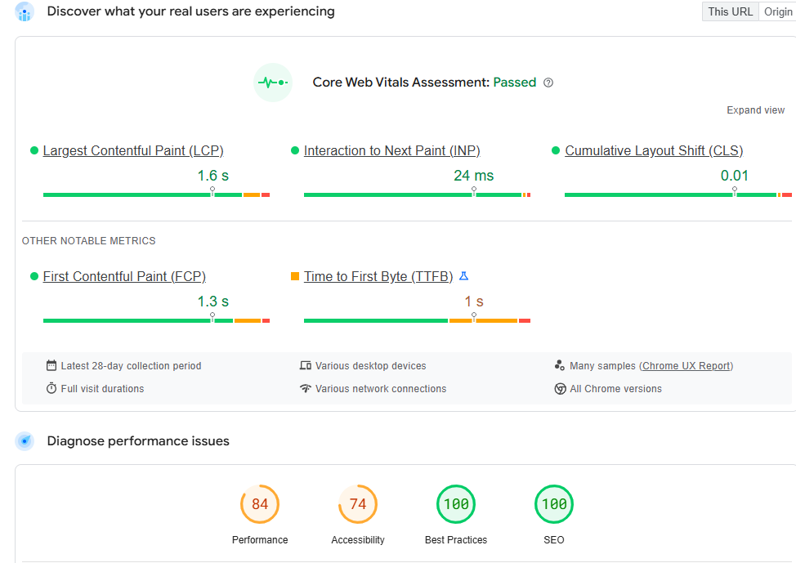
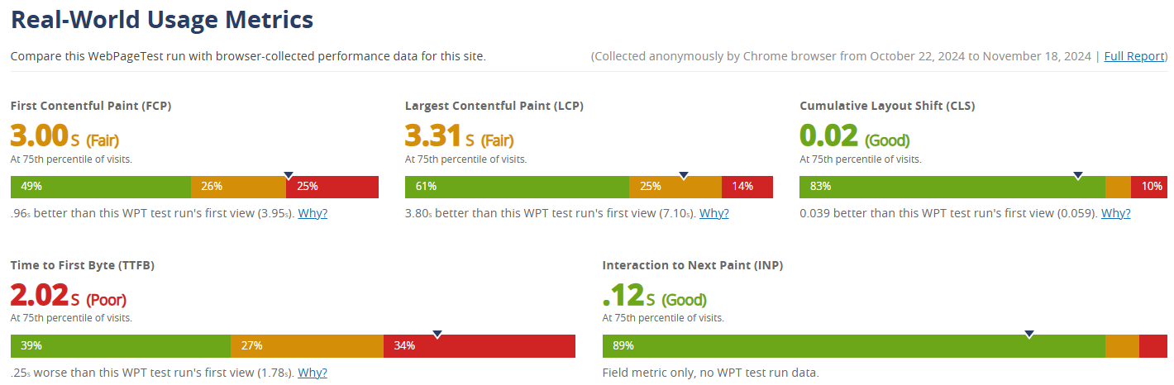
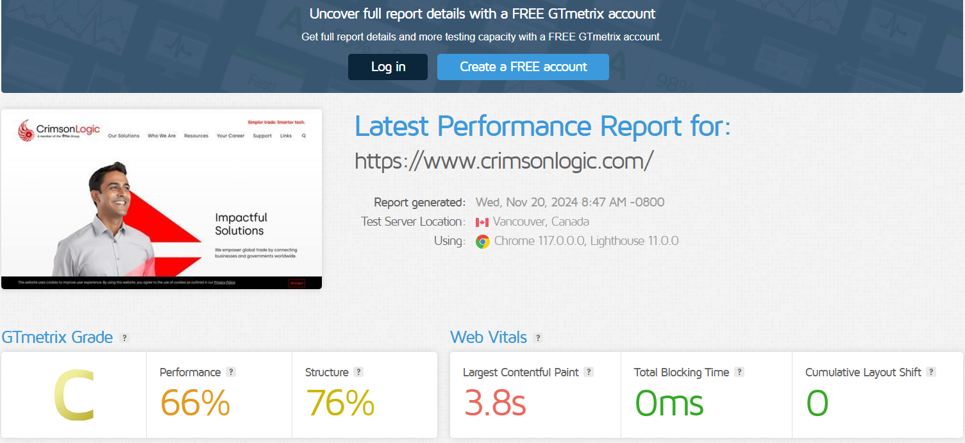
Visual Speed Test
Page Speed Insights
Web Page Test
GT metrix

Slide 22

Mobile-Friendly in Seo
Mobile-Friendly SEO focuses on optimizing a website to ensure it provides an excellent user experience on mobile devices and performs well in search engine rankings for mobile-first indexing.
Key Aspects of Mobile-Friendly SEO
Responsive Design
Ensures the website layout adapts to different screen sizes.
Text, images, and buttons scale properly without zooming or horizontal scrolling.
Mobile Page Speed
Optimizes site speed for mobile networks, ensuring pages load quickly.
Mobile-First Indexing
Google prioritizes the mobile version of websites for indexing and ranking.
Readable Content
Fonts are large enough to read without zooming.
No overlapping or hidden text.
Touch-Friendly Navigation
Buttons and links are large and spaced for easy tapping.
Elimination of Intrusive Pop-Ups
Avoids pop-ups or interstitials that disrupt user experience on small screens.

Slide 23
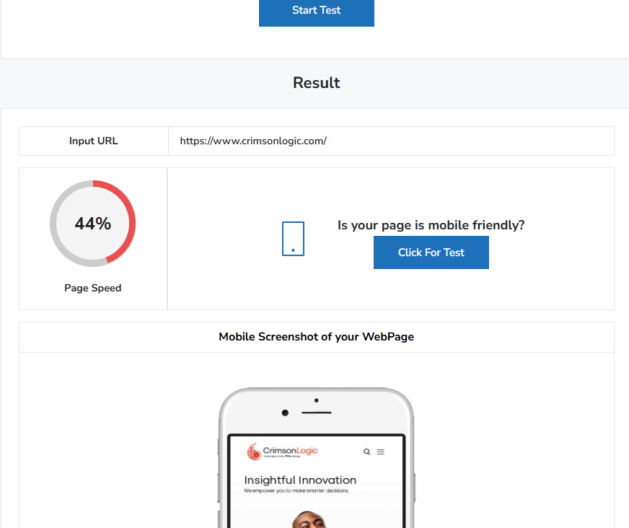
Mobile friendly seo test

